Slide 1
Team Introduction
Project Team & Researchers
Viraj Shah
Project Lead
Ananthi Siva
Team Member
Chanchal Sakarwar
Team Member
Rajashekar Reddy Mettu
Team Member
Sreedhar P Reddy
Team Member

Slide 2
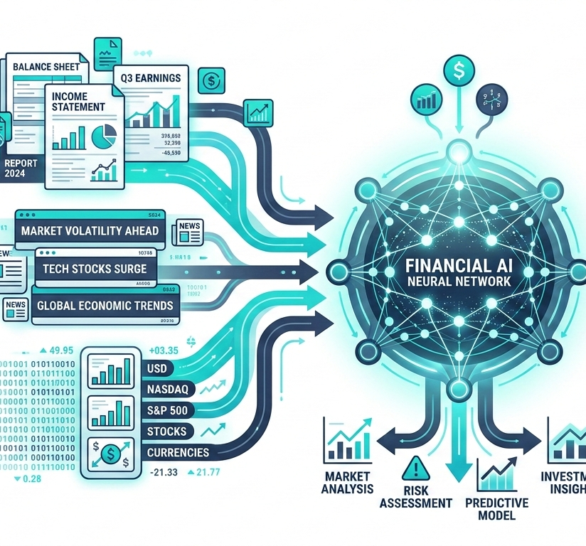
Financial Sentiment Analysis with Statistical Models, Deep Learning & LLMs
Evaluating multi-architecture NLP performance on complex domain-specific financial text
PROBLEM DEFINITION
This project investigates the application of Statistical Models, Deep Learning Based Models, and Large Language Models (LLMs) for Financial Sentiment Analysis (FSA).
We benchmark models like GPT-OSS-120b, GPT-OSS-20b, Qwen3.8-27b, and Gemini-Flash-Lite-Latest against domain-specific API models on complex financial texts.
PROJECT OBJECTIVES
Extracting opinions and market sentiment from diverse financial data sources:
article
Financial news articles
analytics
Comprehensive financial reports
campaign
Official company announcements

Slide 3

Real-World Applications of Financial Sentiment AI
How LLMs process unstructured market data into real-time trading signals, earnings analysis, and enterprise risk intelligence.
trending_up
ALGORITHMIC TRADING & SIGNALING
Automating buy/sell signals by ingesting real-time financial news and SEC filings, enabling high-frequency models to execute trades fast.
01
analytics
EARNINGS CALL & ANNOUNCEMENTS
Parsing executive tone and complex financial statements during earnings releases to measure corporate health and leadership sentiment.
02
shield
ENTERPRISE RISK & INTELLIGENCE
Monitoring systemic market risks, credit default signals, and regulatory news to provide portfolio managers proactive risk mitigation insights.
03

Slide 4
Dataset & EDA Results
Overview of Financial PhraseBank Dataset, Class Distribution, and Train/Test Split
TOTAL DATASET
SPLIT ARCHITECTURE
STRATIFICATION
Dataset Shape & Source
Financial PhraseBank benchmark metrics
Train & Test Partitioning
Stratified subset distribution (test_size=0.20)
Class Distribution
Balanced sentiment category allocation
FINAL DATASET SHAPE
(4,840, 2)
SPLIT RATIO
80% / 20%
METHODOLOGY & BALANCE
1. Class Stratification: Executed via stratify=df['Sentiment'] to preserve label proportions across sets.
2. Target Classes: Stratified mapping covering Positive, Neutral, and Negative sentiment targets.
3. Data Integrity: Ensures zero class imbalance skew during baseline and LLM model training.
Maintains uniform statistical distribution for cross-validation and evaluation integrity.
KEY ATTRIBUTES
Source: Financial PhraseBank (via Kaggle Hub)
Total Samples: 4,840 (deduplicated)
Columns (2): Sentiment & News Headline
Classes: Positive, Neutral, Negative
Preprocessing: Lowercase normalization
SUBSET BREAKDOWN
Training Set: 3,872 samples (80%)
Training Shape: (3872, 2)
Test Set: 968 samples (20%)
Test Shape: (968, 2)
Stratification: Uniform target ratio

Slide 5
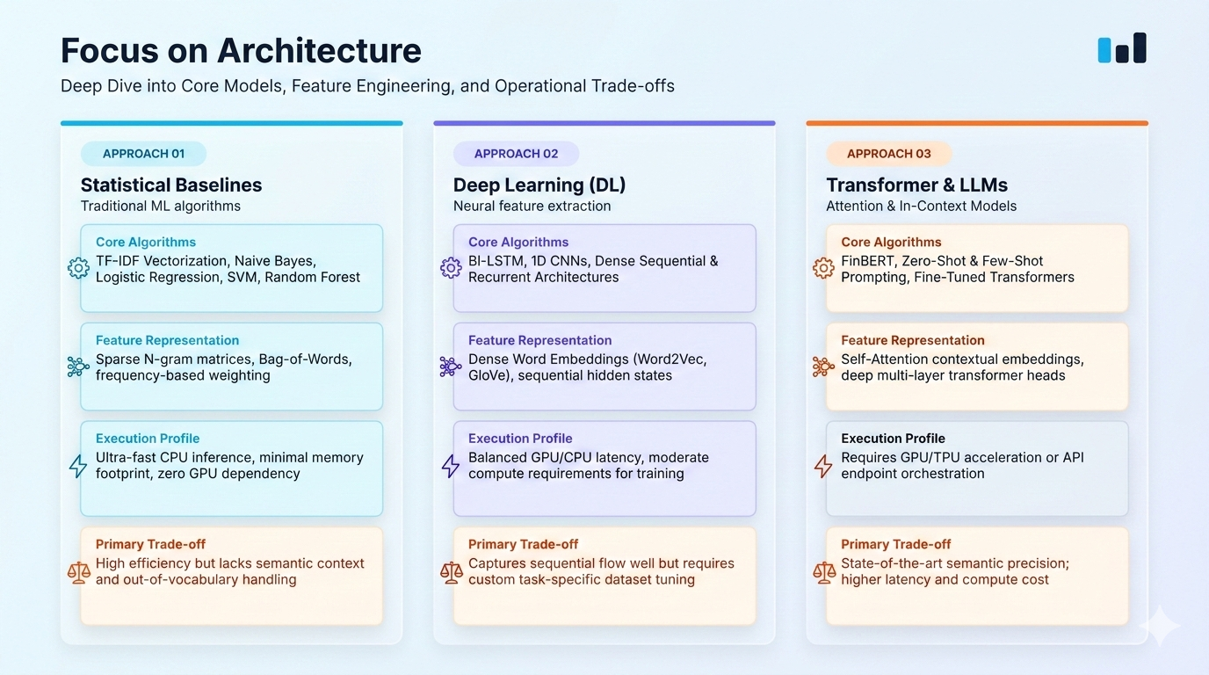

Slide 6
Comparisons of Approaches
Evaluating Large Language Model Learning Paradigms for FSA
NO TRAINING
IN-CONTEXT LEARNING
MODEL ADAPTATION
Zero-Shot Learning
Direct sentiment classification using out-of-the-box model knowledge without task-specific examples.
Few-Shot Learning
Providing a small set of domain-specific reference examples directly within the input prompt.
Fine-Tuning (FinBERT)
Supervised retraining of specialized language models on target financial phrasebooks.
Prompt Strategy
Direct natural language instructions defining financial sentiment classes.
Prompt Strategy
Guiding LLMs (e.g., GPT-OSS-120b, GPT-OSS-20b, Qwen3.8-27b and Gemini) with curated exemplar financial texts.
Optimization
Updates internal weights using datasets like Financial PhraseBank.
✓ Key Advantage
Instant deployment with zero data labeling or computational overhead.
✓ Key Advantage
Significantly improves output alignment without updating model weights.
✓ Key Advantage
Achieves peak accuracy on specialized financial terminology & metrics.
⚠ Primary Challenge
Struggles with subtle financial jargon and complex context nuances.
⚠ Primary Challenge
Bounded by prompt token limits and highly sensitive to example selection.
⚠ Primary Challenge
Requires labeled dataset infrastructure and training compute.

Slide 7
Conclusion & Research Limitations
KEY TAKEAWAYS & FINDINGS
RESEARCH LIMITATIONS
Comparative Analysis
Benchmarking general-purpose LLMs (GPT-OSS-120b, Qwen3.8-27b, GPT-OSS-20b, Gemini-Flash-Lite-Latest) against domain-specific models highlights the efficacy of task-specific pre-training on financial corpora.
Domain vs. Generalization
FinBERT excels in financial sentiment tasks but lacks the broad conversational generalization and context adaptivity of large foundation models.
Fine-Tuning Impact
FinBERT, pre-trained and fine-tuned on Financial PhraseBank, demonstrates robust domain vocabulary understanding and high classification reliability with low inference latency.
API vs. Local Inference
LLM evaluation via API endpoints introduces rate-limiting and latency constraints compared to dedicated local transformer inference setup.
Prompt Paradigm Flexibility
While general LLMs require careful prompt tuning or few-shot examples to achieve comparable performance, they offer significantly greater flexibility across diverse textual formats.

Slide 8
Demo Section & Interactive Testing UI
Unified interactive playground for evaluating Statistical Baselines, Deep Learning, and LLM Inference Paradigms
INTERACTIVE DEMO 01
INTERACTIVE DEMO 02
INTERACTIVE DEMO 03
Statistical Models UI
Baseline ML model inferencing environment
ChatGPT & Qwen Playground
Open & Closed OSS Foundation LLMs
Gemini API Evaluation
Flash & Lightweight LLM testing
KEY TARGETS & FEATURES
Models: Logistic Regression, Linear SVM, Random Forest
Vectorization: TF-IDF (1,2-grams)
Latency: Ultra-fast CPU inference (<10ms)
Dataset: Financial PhraseBank / News Headlines
Output: Class probability & confidence scores
KEY TARGETS & FEATURES
Models: GPT-OSS-120b, Qwen3.8-27b, GPT-OSS-20b
DL Baselines: FinBERT
Paradigm: Zero-Shot & Few-Shot Prompting
Flexibility: High textual adaptivity
Evaluation: Multi-prompt structured output
KEY TARGETS & FEATURES
Models: Gemini-Flash-Lite-Latest
Integration: REST API Endpoint Orchestration
Trade-offs: Rate-limiting vs context quality
Inference: Managed cloud API execution
Output: Real-time sentiment predictions
🔗 Open Notebook Demo
🔗 Open ChatGPT, Qwen and FinBert Demo
🔗 Open Gemini Demo

Slide 9
FLOOR OPEN
Questions & Answers
Open forum for discussion, feedback, and further inquiries.
forum
Have any questions?
Feel free to ask anything about the presentation topics, methodology, or outcomes.

